Slide 1
Proof Synthesis via Symbolic and Neural Approaches
Optimization for Deep Learning, 2024, Purdue University
Presenter: Xuyang Li

Slide 2
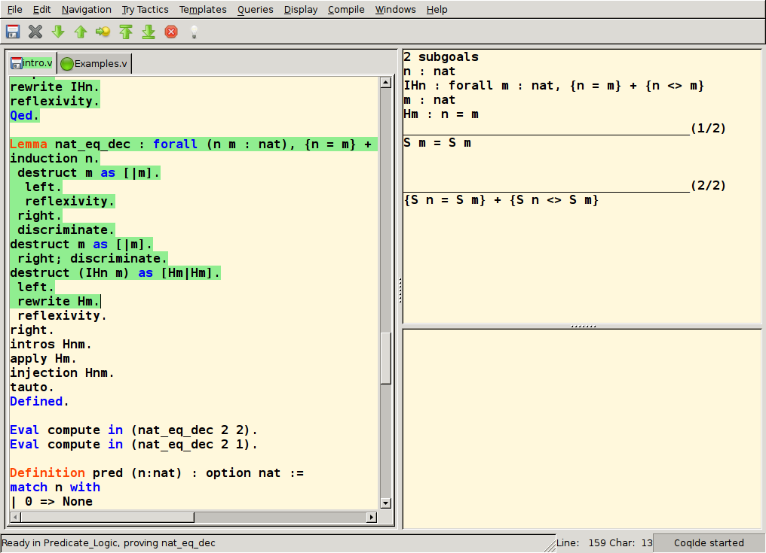
Interactive Theorem Proving (ITP)
ITP allows for writing rigorous and machine-checkable proof with special programming languages.

Slide 3
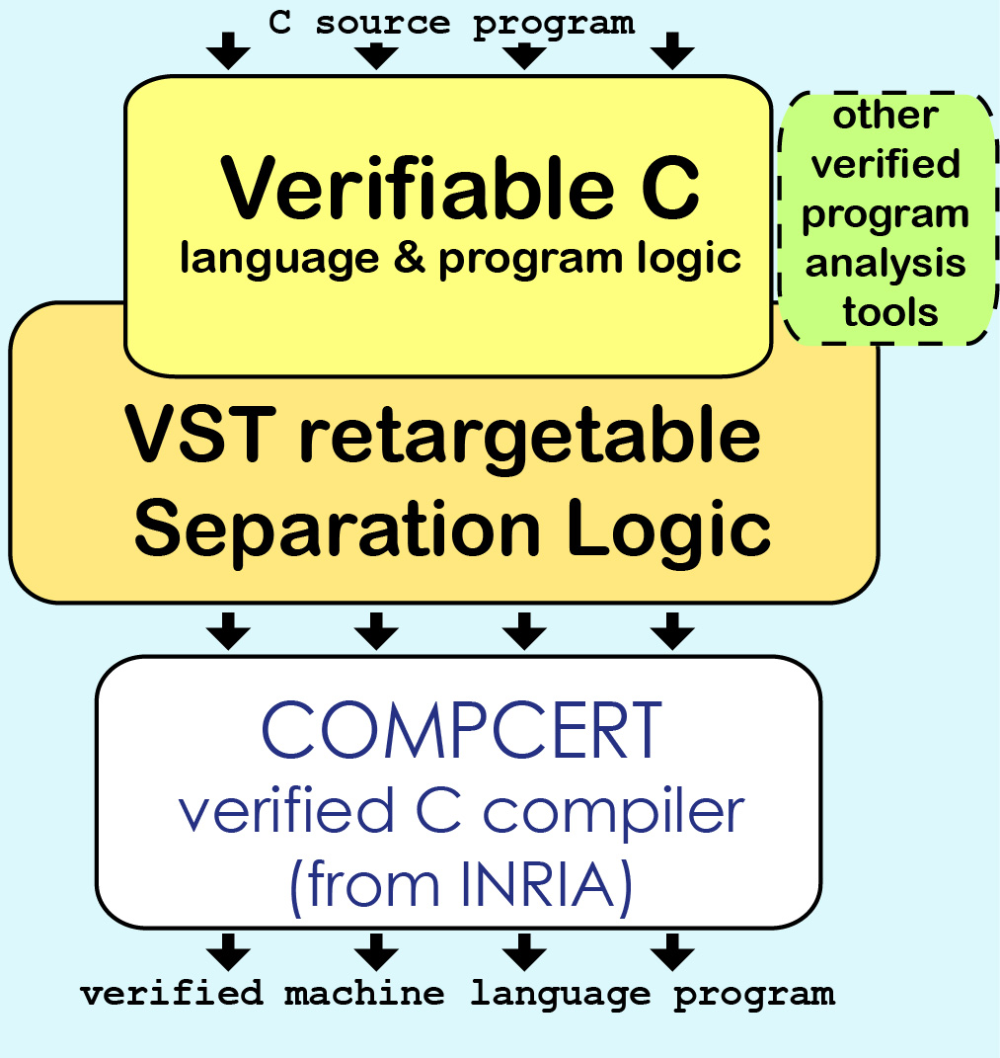
Interactive Theorem Proving (ITP)
… It enables software verification, e.g. on C programs and compilers.

Slide 4
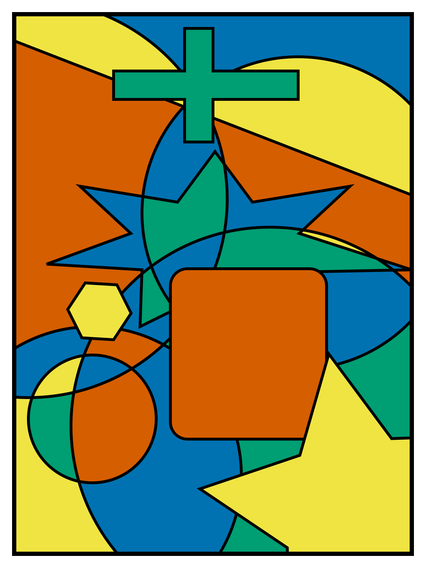
Interactive Theorem Proving (ITP)
… It enables math theorem like 4-color theorem.

Slide 5
ITP is laborious
Like in software verification of CompCert, it had 100,000 Coq lines and demanded 6 person-years of effort in 2017
Normally the proof of a verified software is up to 10 times longer than its source code

Slide 6


Proof synthesis: writing proof automatically
How to finish this theorem (add_comm)?

Slide 7
Demo: Interactive Theorem Proving in Coq proof Assistant
You can test on https://coq.vercel.app/scratchpad.html with below script:
Require Import Coq.Arith.Arith.
Theorem add_comm: forall n m, n + m = m + n.
Proof.
induction n.
- intro. simpl. rewrite Nat.add_0_r. auto.
- intro. simpl. rewrite -> IHn. rewrite Nat.add_succ_r. auto.
Qed.

Slide 8
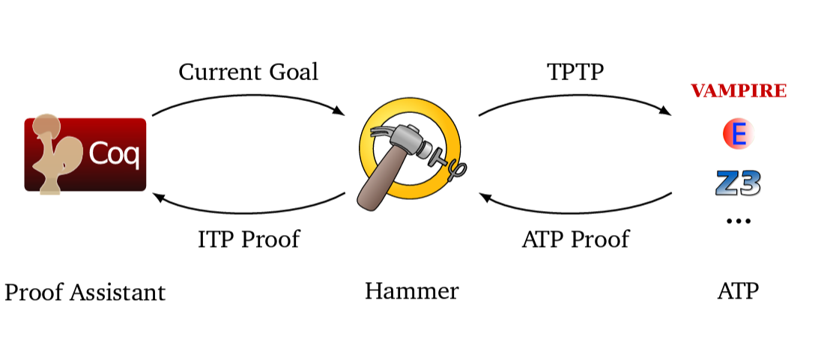
Symbolic techniques
Leverage automated theorem provers (ATP) like Z3
Need translations between logic theories of ITP and ATP
Is accurate at low-level details
Not good at high-order and inductive reasoning
Figure from: https://lukaszcz.github.io/papers/coqpl-pres.pdf

Slide 9
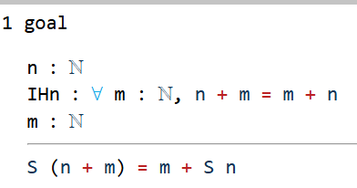
Demo: symbolic proof synthesizer in Coq, Coqhammer
Require Import Coq.Arith.Arith.
Theorem add_comm: forall n m, n + m = m + n.
Proof.
induction n.
- intro. simpl. rewrite Nat.add_0_r. auto.
- intro. simpl. rewrite -> IHn. rewrite Nat.add_succ_r. auto.
Qed.
(*Proof state*)
(*hammer output*)
sfirstorder.
Qed.

Slide 10
Neural techniques
Due to the uncertain nature, neural techniques perform badly by themselves alone, but they provide good sketch for high-level proof structures
Self-trained ML models vs LLM+few-shot learning
They all need to cooperate with symbolic techniques for low-level details
More efficient than symbolic approaches

Slide 11
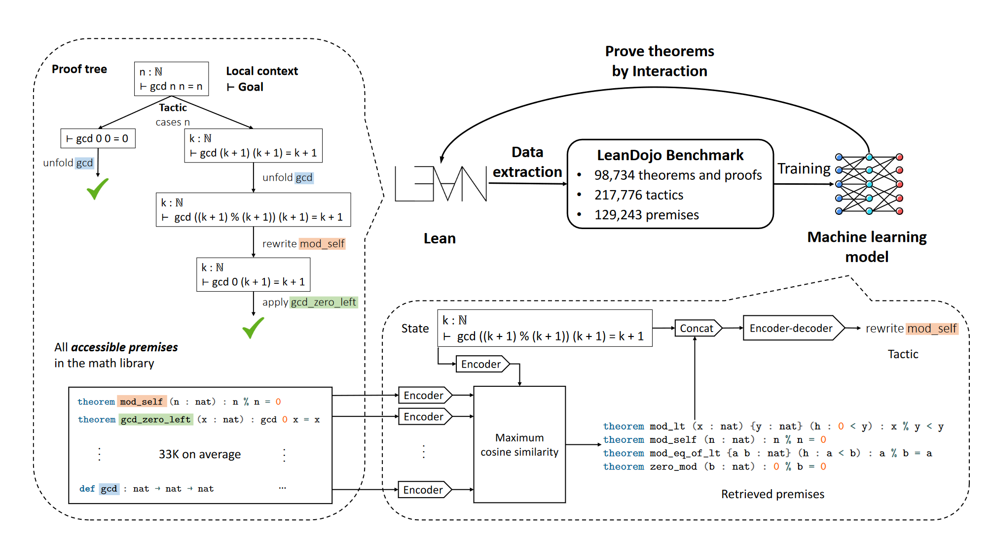
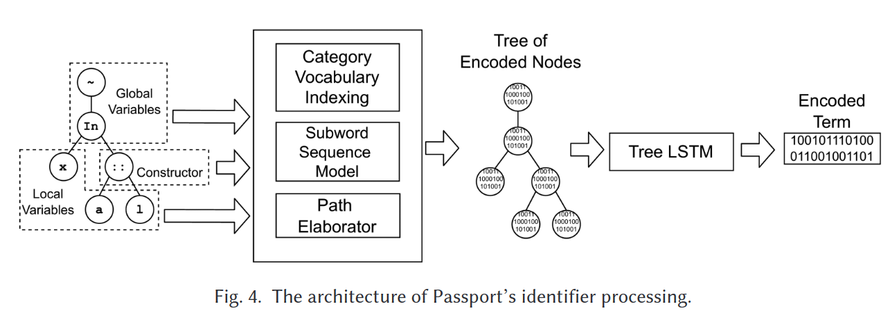
Neural techniques: training a specialized model
Feature engineering
Premises selection
Figure from: Passport: Improving Automated Formal Verification Using Identifiers
Figure from: Leandojo

Slide 12

Demo: LLM-based proof synthesis
Require Import Coq.Arith.Arith.
Theorem add_comm: forall n m, n + m = m + n.
Proof.
induction n.
- intro. simpl. rewrite Nat.add_0_r. auto.
- intro. simpl. (*We stop here*)
rewrite -> IHn. rewrite Nat.add_succ_r. auto.
Qed.
(*Proof state*)
(*LLM output*)
rewrite <- plus_n_Sm.
rewrite IHn.
reflexivity.
Qed.

Slide 13
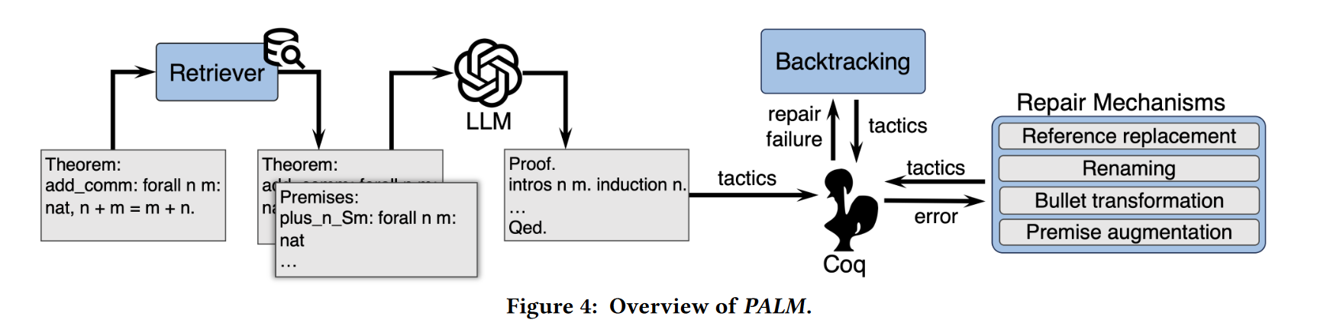
Combination of symbolic and neural approaches:
PALM as an example
Generate-than-repair: simple but effective
Observe how LLM fails and design repair mechanism case-by-case
Try symbolic approaches when possible
Figure from: Proof Automation with Large Language Models

Slide 14
Thanks

